Slide 1
Models for sustainable civil society organizations
Kim Bettcher, Phd
Democracy lounge
October 27, 2022

Slide 2
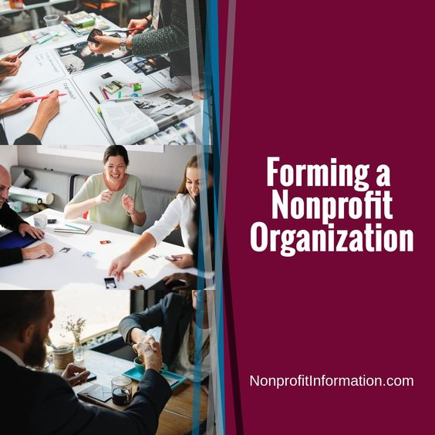
Sustainable CSOs…
1. Remain true to their mission
2. demonstrate strong leadership and governance
3. create diversified revenue streams
4. Communicate effectively with stakeholders

Slide 3

Closing Civil society Space
Notes:
1993-2012 39 countries adopt laws adopted restricting donor funding for NGOs (source: World Development 84)
2012-2015 60 countries pass 120 laws restricting activities of NGOs. 40 laws restrict foreign funding of NGOs. (source International Center for Not for Profit Law)

Slide 4
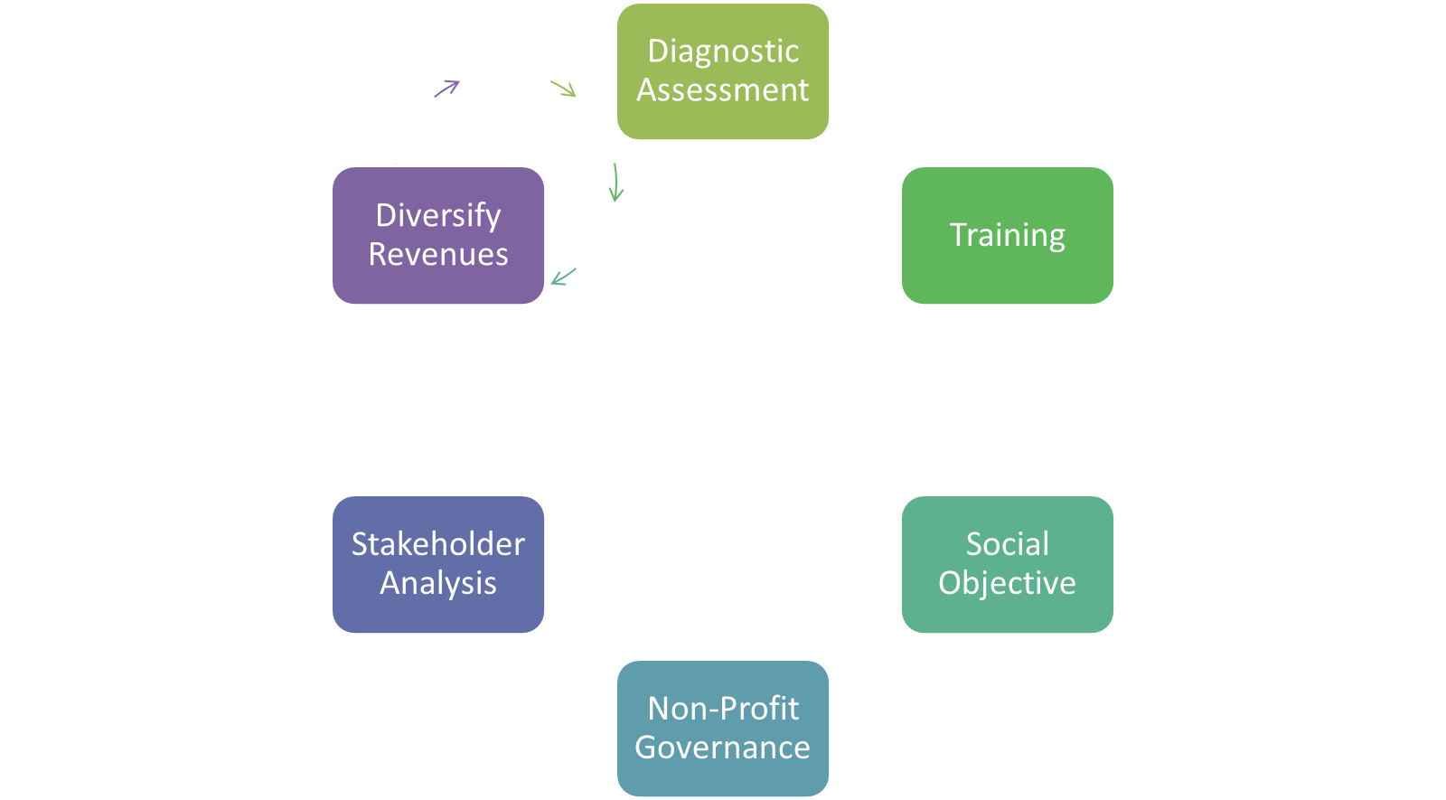
6 Steps to build a sustainable CSO

Slide 5
Diagnostic Assessment
Organizational Capacity Assessment Tool (OCAT)
Marguerite Casey Assessment Tool

Slide 6
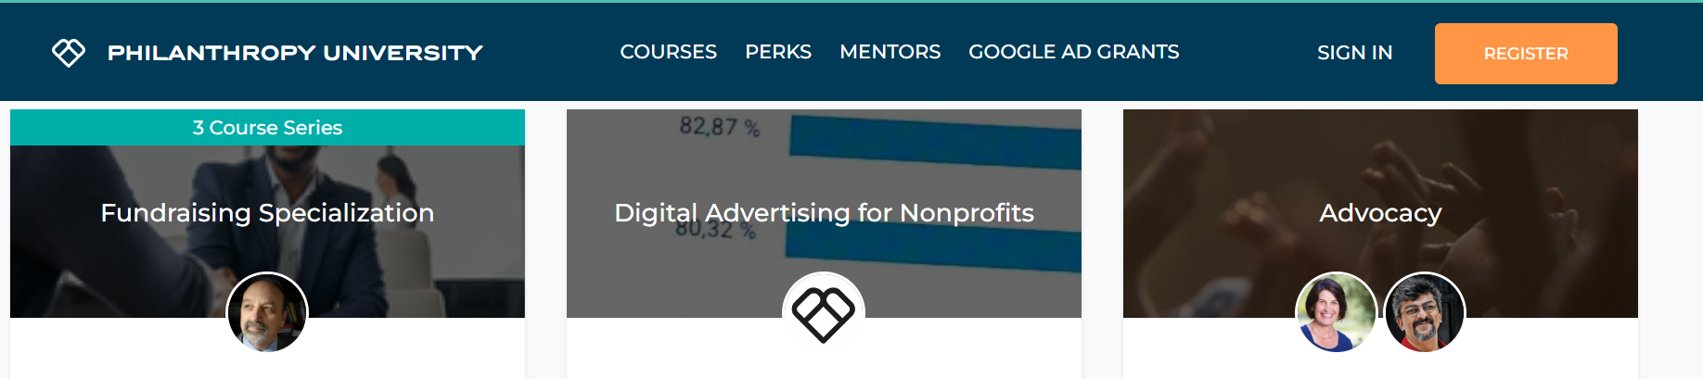
Training
Philanthropy University

Slide 7
Social Objective
How does your organization benefit society?
What is your value proposition?
Organization | Interest served | Social Objective
Kenyan Well-Drillers Association | We represent the commercial interests and provide training to well-drilling firms in Kenya. | We ensure communities in Kenya with affordable, quality access to fresh potable water.
Business Women’s Forum | BWF works to strengthen the role of businesswomen as leaders in the economy. | BWF helps to create a more vibrant economy by fully engaging women entrepreneurs in the formal market.
Your organization
Notes:
Have audience go through developing their own social objective statements.
It is not WHAT you do but WHY
Explain the social and Economic Benefits to Society

Slide 8
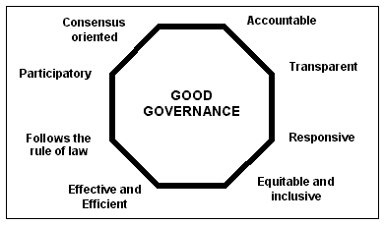
Good Governance
Notes:
Talk about having a Board, Policies, Procedures
Talk about Duty of Care, Loyalty, and Obedience
Go through an exercise with Participants

Slide 9
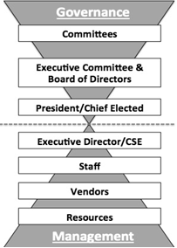
Roles & relationships
Notes:
Talk about having a Board, Policies, Procedures
Talk about Duty of Care, Loyalty, and Obedience
Go through an exercise with Participants

Slide 10
Identify your Stakeholders
Whom do you serve?
Do you have any allies among NGOs, Business, Government?
What donors are interested in your social objective?
Whom can you recruit as volunteers?
Customers: Fee payers | Allies: Policy partners
Members: Dues payers | Partners: Providers
Copyright by Rick O’ Sullivan, Change Management Solutions

Slide 11
Diversify Revenues
Fundraising _______
Memberships _______
Project Financing _______
Organization Grants _______
Products/Fee for service _______
Sponsorships _______
100%
Notes:
Financial Donations/Fundraising are funds received through specific solicitation activities
Project Financing are funds received for a specific purpose/project and can only be used for that project.
Org Financing refers to financing for the organization to achieve the organization’s purpose or vision.
Products and/or Services are funds received for providing specific products/services to general public could include (food services, childcare, training, artisanal sales, health services, etc.
OR Government; Individual Donors; Corporate Donors; International Cooperation
Strategy ties to the stakeholder and their motivations, relationships.

Slide 12
Know your financial health
Quarterly reports
Revenues | YTD Actual | Budgeted | % of Budget
Expenses | YTD Actual | Budgeted | % of Budget
Operating reserves: Target 3+ months reserve
Vulnerability of revenue sources: Demand for services; membership trend; external pressure

